Slide 1

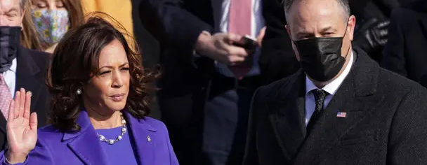


Douglas Emhoff
The First Second Gentleman
Student Support & Attendance Services
Human Relations, Diversity & Equity
Notes:
Teacher, thank you for choosing this advisory lesson to share with your students. Please make sure to review classroom norms before moving further.

Slide 2
Welcome!
Would you rather...
Read the book
Watch the movie
Notes:
Please engage the students in the check in question.

Slide 3
Objectives
Learn about the history of the Second Lady/ Gentleman
Review Douglas Emhoff's early life and journey to Second Gentleman
Discuss the impact of Doug Emhoff's unique identity in this role
Notes:
Please read the objectives aloud for the students.

Slide 4
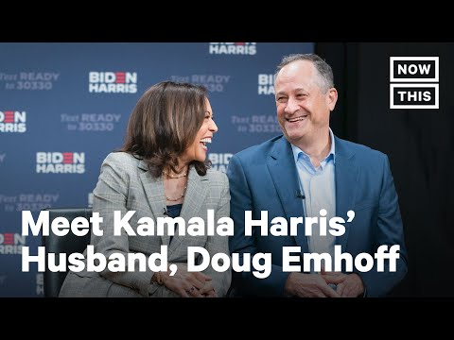
Who is
Doug Emhoff?
z
Notes:
Play the video for the students (4:12)
https://www.youtube.com/watch?v=S6c83r00v8s

Slide 5
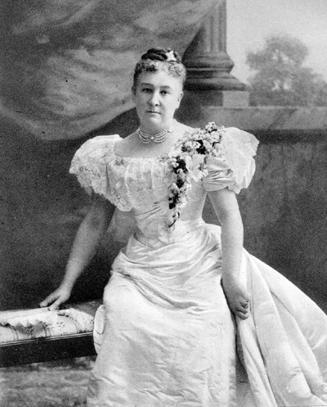
The Second Lady or
The Second Gentleman
The Second Lady or Second Gentleman of the United States is an informal title held by the spouse of the Vice President of the United States of America.
The Second Lady title was first used by Jennie Tuttle Hobart (wife of VP Garret Hobart) in 1897.
The Second Gentleman title was first used by Doug Emhoff (husband of VP Kamala Harris) in 2021.
Notes:
Read the slide aloud for the students – advise the students that this picture is of the first Second Lady to use the title – Jennie Tuttle Hobart – in 1897.

Slide 6
Reflection
The title of the spouse of the President (First Lady) or Vice President (Second Gentleman) is glaringly gender specific.
How might we address these individuals without having to mention their gender?
Notes:
Engage the students in the reflection question

Slide 7


Early Life
Doug Emhoff was born in 1964 in Brooklyn New York.
At 17 years old, Doug and his family moved to California.
Doug got his Bachelor's degree from California State University, Northridge and his Law Degree from USC.
Notes:
Read the slide aloud for the students

Slide 8
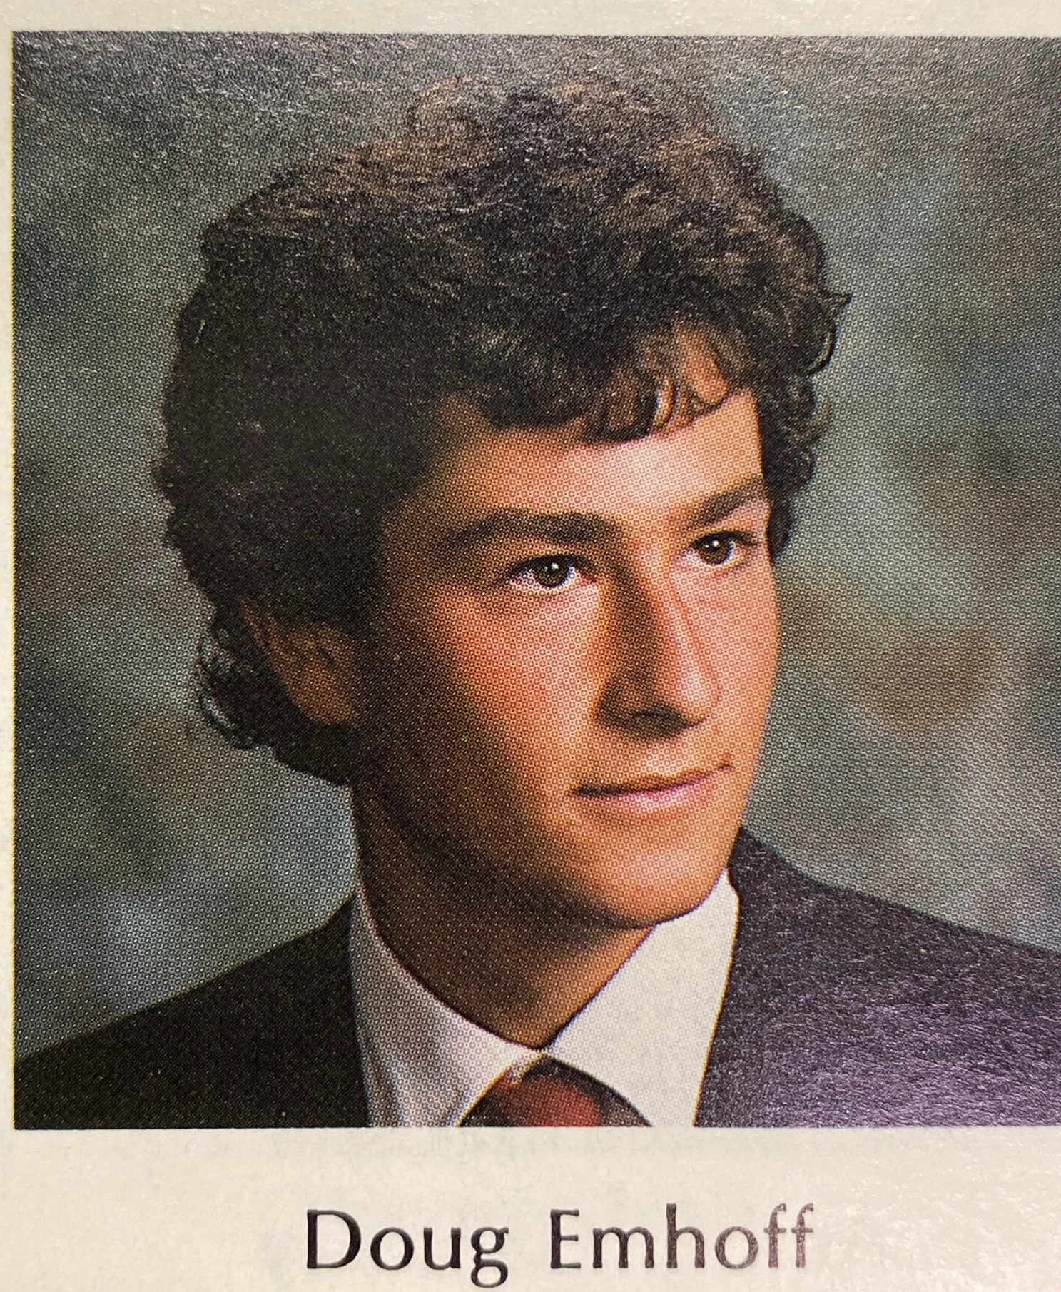
Career
Doug began his career as an entertainment lawyer, with clients including Walmart and Merck.
Doug joined the firm DLA Piper in 2017, but took leave in 2020, following the announcement that his wife, Kamala, would be Joe Biden's running mate.
Following Biden/Harris election win, Doug announced he would permanently leave his job.
Notes:
Read the slide aloud for the students

Slide 9
Reflection
The spouses of the president and vice president do not have official roles, but they are typically expected to take on a variety of social causes and projects.
So, why then, do you think Doug Emhoff quit his job as a lawyer?
Notes:
Invite the students to engage in the reflection question. After hearing their ideas, share with them that per the White House official statement, Emhoff quit his job "to avoid conflict of interest concerns". Elaborate a bit on what this may mean.
Also advise the students that the "social cause/project" Emhoff has selected is to focus on "equal access to justice and legal representation for all"

Slide 10
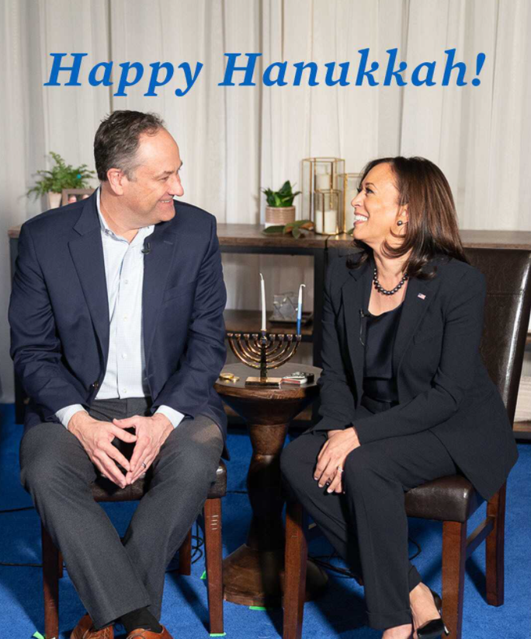
Other Notable Firsts
Doug Emhoff is the FIRST Second Gentleman, but that is not his only first.
He is also the First Jewish spouse of a US president or Vice President ever.
Notes:
Read the slide aloud for the students

Slide 11
Reflection
It's 2021. Doug Emhoff is the first Jewish spouse of any President or Vice President
In over 200 years of presidencies, there has never been a Jewish spouse of a President or Vice President?
Why do you think that is?
Do you think it matters?
Notes:
Invite the students to engage in the reflection question. After hearing their ideas, share with them that per the White House official statement, Emhoff quit his job "to avoid conflict of interest concerns". Elaborate a bit on what this may mean.
Also advise the students that the "social cause/project" Emhoff has selected is to focus on "equal access to justice and legal representation for all"

Slide 12
Check Out
Which would you rather have for a pet?
Snake
cow
Notes:
Engage the students in the check out question

Slide 13

Human Relations, Diversity & Equity https://www.lausd.org/human-relations
z

Slide 14
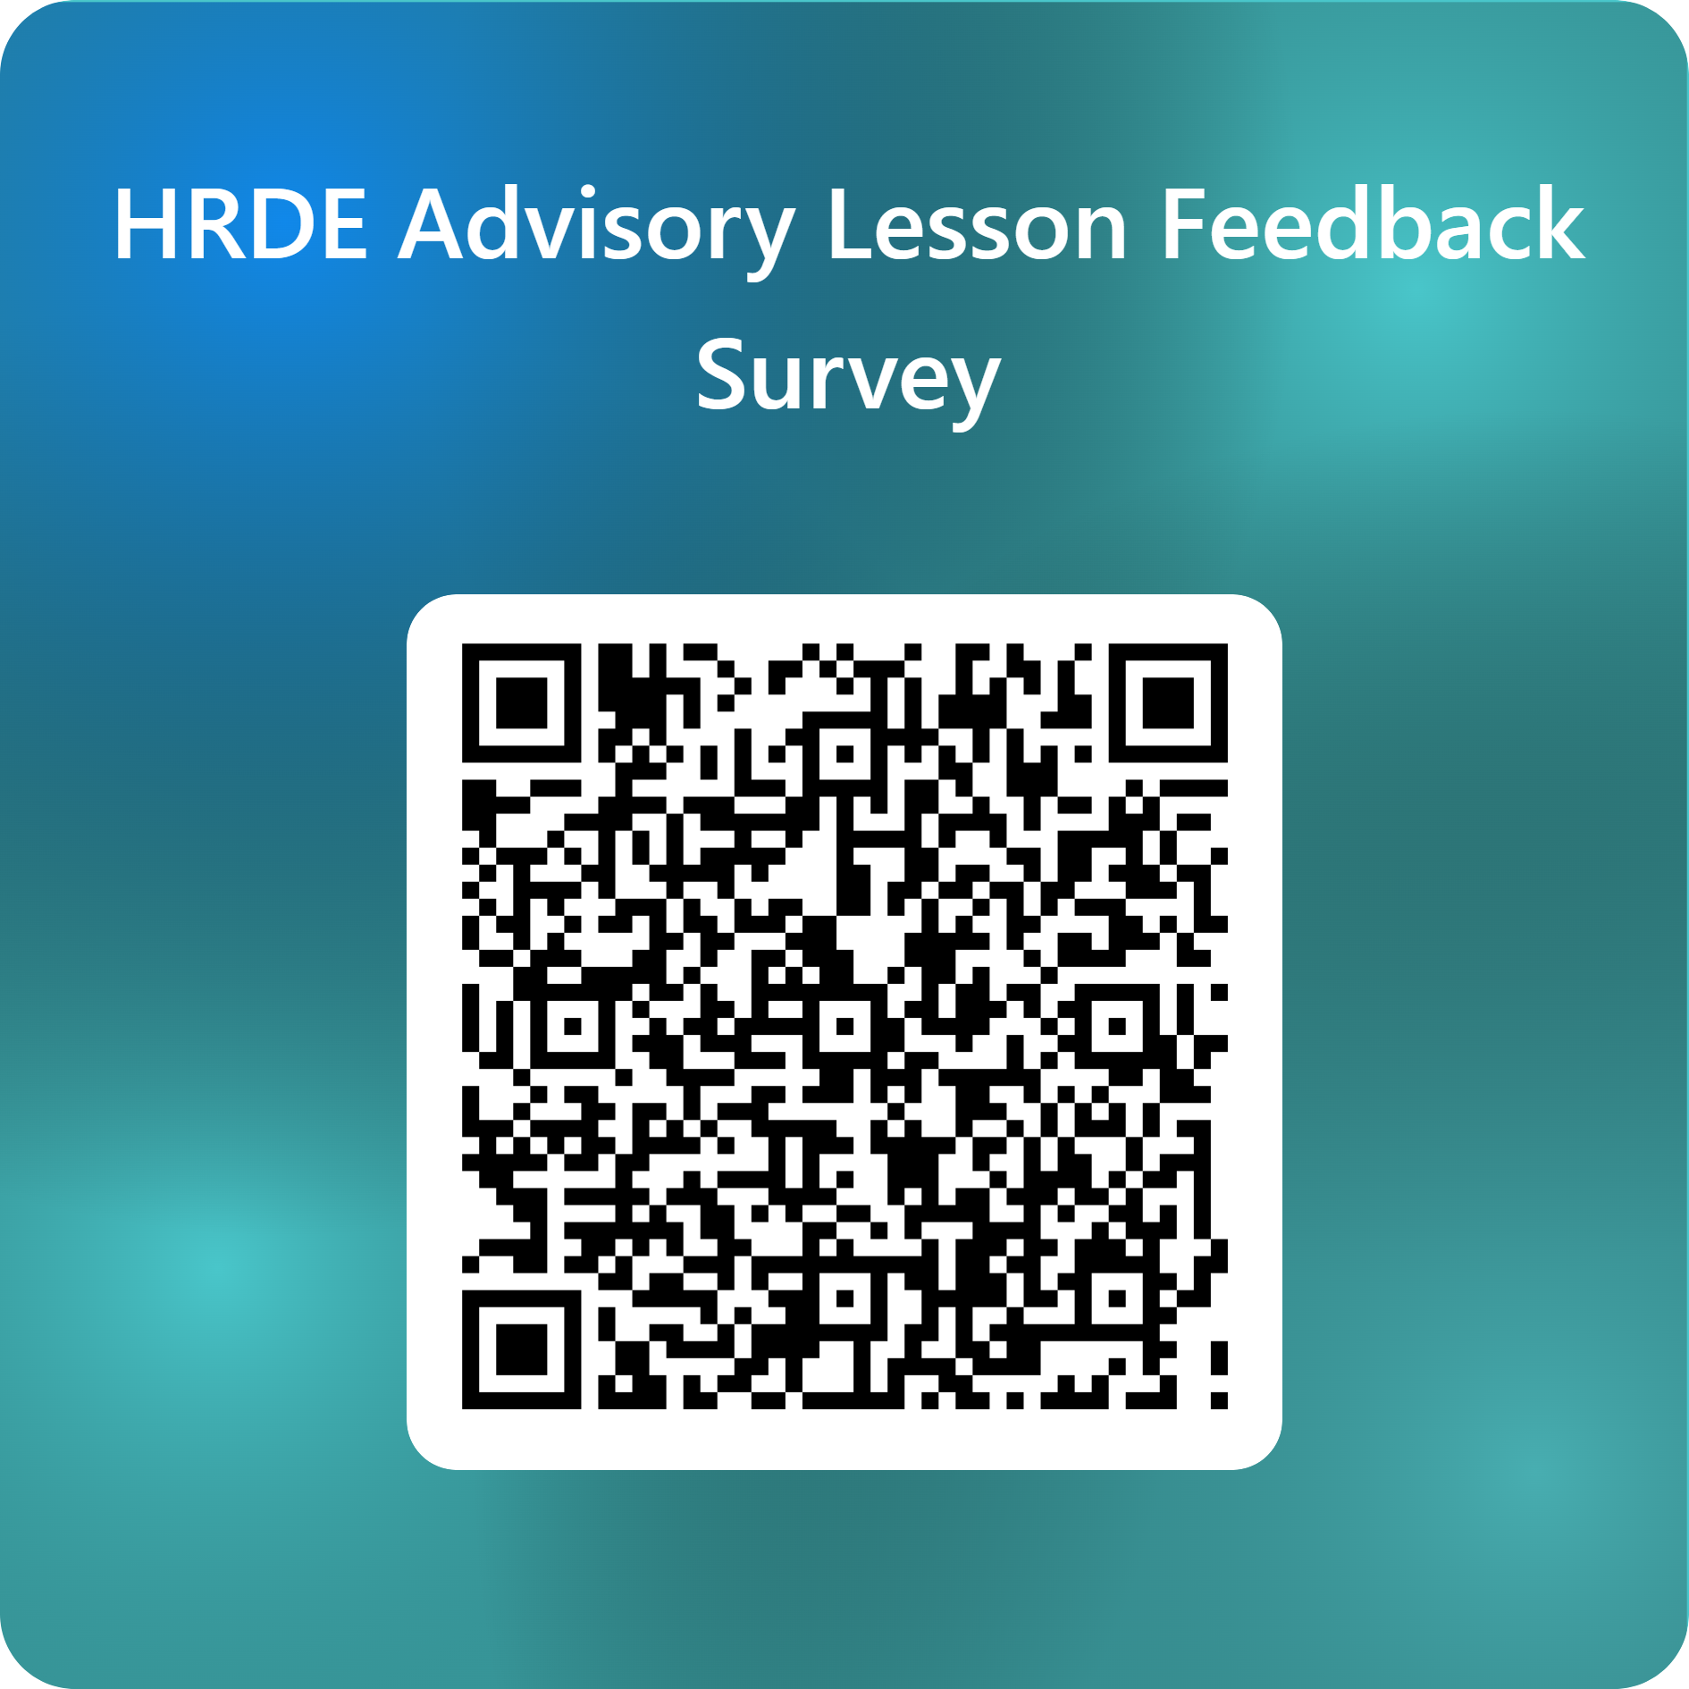
Teacher Feedback
z
Notes:
Teacher, please complete a brief feedback survey by scanning the QR code or using the link below
https://forms.office.com/r/i9UqyyxzTT

